Slide 1
Overview of the World Wide Web
cp.shewell@ulster.ac.uk

Slide 2
What Isn’t The Web
The internet is not the web.
The internet consists of many applications, not just the web, other applications include:
Email.
SSH.
FTP.
Video game communication.
The applications may run on a specific protocol, such as SMTP.

Slide 3
What Is The Web?
The World Wide Web (WWW), the web, is a large collection of documents and files that are accessible via the internet.
Web information is stored in documents called Web pages.
A Web site is a collection of Web pages written by one Web page author or a team of Web page authors.

Slide 4
What Is The Web?
Computers reading the Web pages are called Web clients.
Web pages are files stored on computers called Web servers.
Web clients view the pages with a program called a Web browser.
The protocol that web browsers use to communicate with web servers is HTTP.

Slide 5
What Is The Web?
TCP/IP operates across the internet and gives each client and server an IP address.
Communications on these IP addresses is split into ports to allow multiple applications to communicate, ports are 0 to 65535 (16-bit range).
HTTP communicates over TCP/IP, typically on port 80. HTTPS is a secured version of HTTP that typically communicates on port 443.

Slide 6
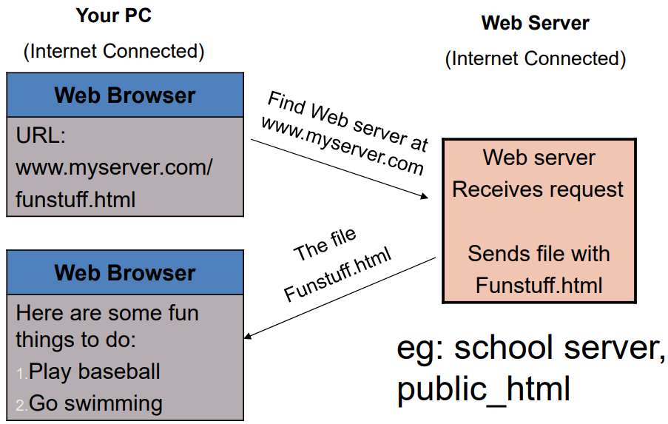
How Do Browsers Fetch Pages?

Slide 7
What’s In a Page?
All Web pages contain instructions for display • The browser displays the page by reading these instructions.
The most common display instructions are called HTML tags, created by HTML (Hypertext Markup Language).
HTML ‘marks up’ content though tags, providing structure and semantics.

Slide 8
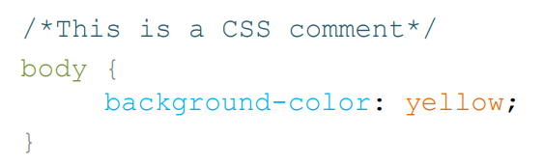
What’s In a Page?
Web pages also typically contain:
Cascading Style Sheets (CSS) – Providing style information to determine how to present the marked up content.

Slide 9
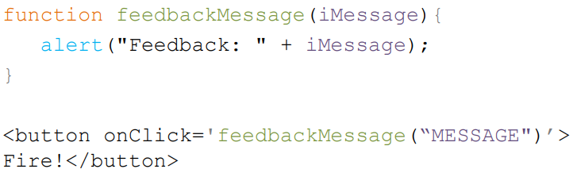
What’s In a Page?
Web pages also typically contain:
JavaScript/ECMAScript – providing a way to enable programmatic functionality within a web page.

Slide 10

What’s In a Page?
Web pages also typically contain:
Linked multimedia assets – such as Images/Videos.
CSS/JS may be incorporated through:
Independent files that are specified within the head of a HTML document.
In‐line specification throughout the HTML.

Slide 11
Who Makes Web Standards?
The rule-making body of the Web is the W3C.
W3C stands for the World Wide Web Consortium.
W3C puts together specifications for Web standards.
http://www.w3.org/.
The most essential Web standards are HTML, CSS and XML.
HTML5, CSS3.
XHTML5.

Slide 12
Web Development Toolbox
Client Side:
HTML, CSS.
XML.
JavaScript.
Server Side:
JavaScript, Java.
Perl, PHP.
Databases.

Slide 13
Web Development Toolbox
Online Tools/Resources:
StackOverlow – A great source of help and advice.
Codepen.io – Rapid development tool.
Jsfiddle.net – Rapid development tool.
W3schools.com – A great source of code examples and tutorials.

Slide 14
Static/Dynamic Web Authoring
Historically web authoring focussed on static web pages, these typically loaded an entire page every time a widget was clicked/interacted with.
This approach is inefficient and jarring to the user.

Slide 15
Static/Dynamic Web Authoring
Modern dynamic web authoring produces, rich and interactive web pages through Dynamic HTML.
Benefits of dynamic web pages include:
Increased responsiveness.
More efficient loading of data.
Better user experience.
Interactivity.
Rich multimedia experiences.

Slide 16
DHTML – Dynamic HTML
It is not a special version of HTML.
It is a group of technologies used to create, rich, interactive Web pages:
Cascading StyleSheets (CSS).
Web scripting/JavaScript.
DOM (Document Object Model).
HTML5

Slide 17
DHTML – Dynamic HTML
Some advantages include:
Support by all browsers.
Open standards.
Change content on the fly.
Small size of the file initially served.
No plug-ins required.
Easy to learn, fast development, faster web experience.
More interaction through AJAX.

Slide 18
DHTML – Dynamic HTML
However DHTML has some disadvantages:
Feature level browser and operating system incompatibilities.
Support for handheld devices may require customisation.
Web developer requires more skill.

Slide 19
Web Page Editors
To edit web pages/HTML/CSS/JS an editor is required, these may include:
Notepad++.
Visual Studio Community.
Visual Studio Code.
Brackets.
Sublime Text.
Vim.
Nano.

Slide 20
Basic Web Development Cycle
The Four-Step development cycle:
Save your HTML file.
Load the file into your web browser.
Review the file with your Web browser.
Revise your HTML file with a text editor.

Slide 21
Questions?

